Slide 1
Marketing strategies
Easton White
Alan Hastings
Winter 2018

Slide 2
Learning objectives
By the end of today:
Understand the Fermi calculation from last week
Be able to identify common marketing strategies
Understand your homework assignment for next week

Slide 3
Review from last week
How much does California spend each year on education?

Slide 4

How do marketers market things?
Many strategies that draw heavily on psychology and cognitive science
Notes:
http://www.businessinsider.com/9-sneaky-psychology-tricks-companies-use-to-get-you-to-buy-stuff-2016-2/#priming-1

Slide 5
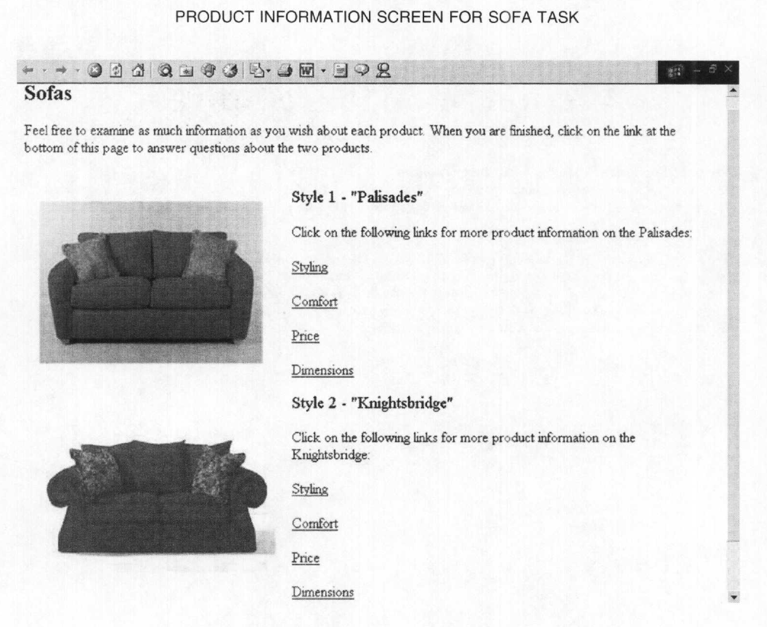
2002 paper by Mandel and Johnson
Notes:
https://www0.gsb.columbia.edu/mygsb/faculty/research/pubfiles/1156/when_web_pages_influence_choice.pdf

Slide 6
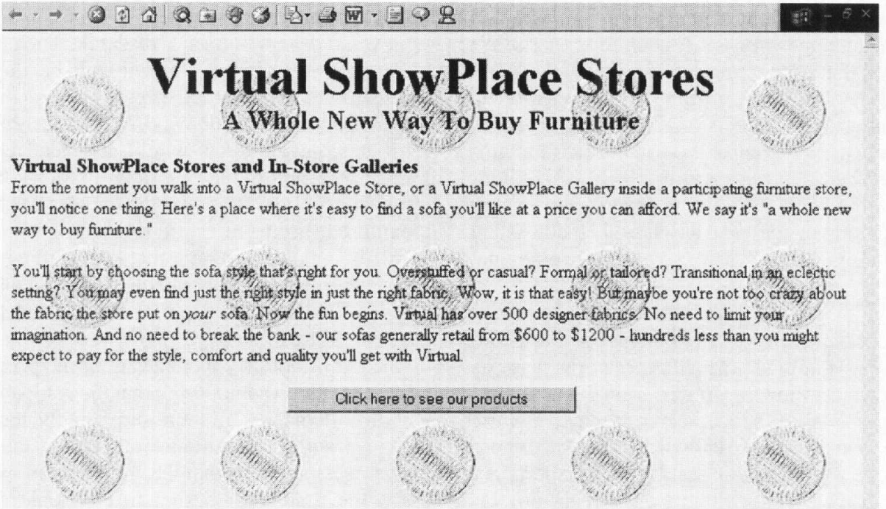
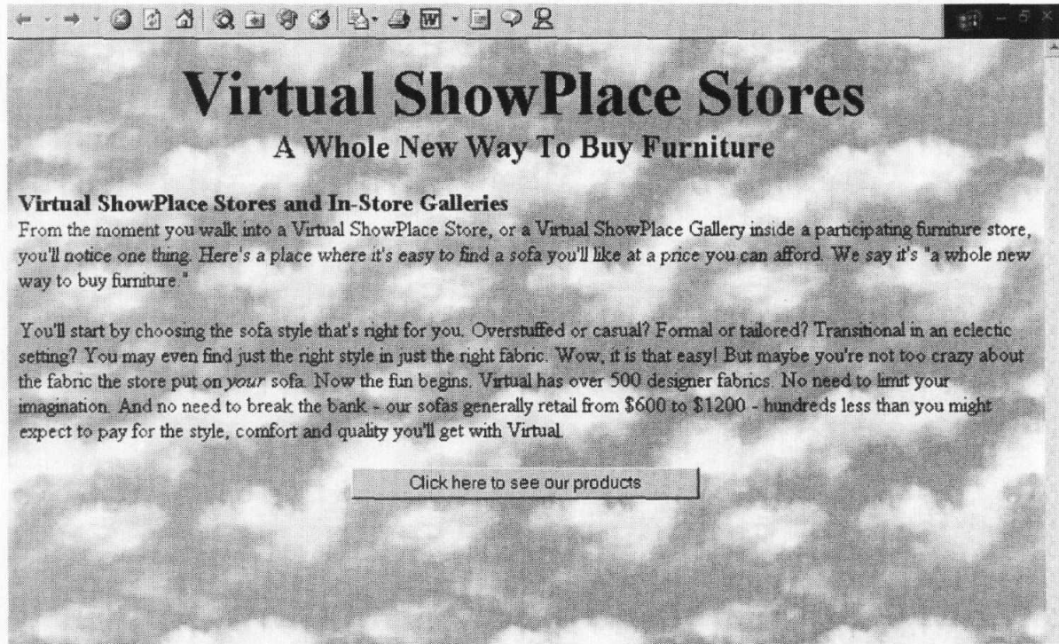

Slide 7
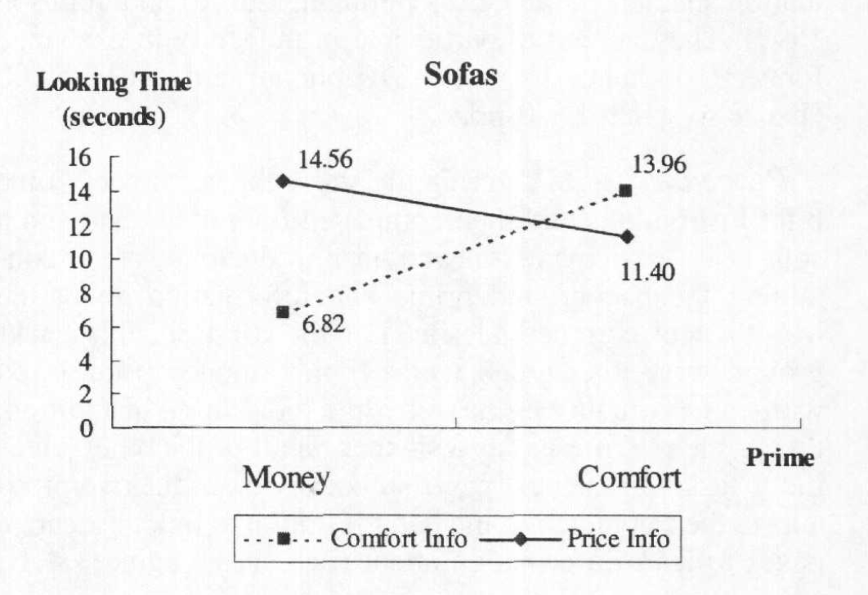
Priming
Being exposed to one idea may affect how you feel about a subsequent idea

Slide 8
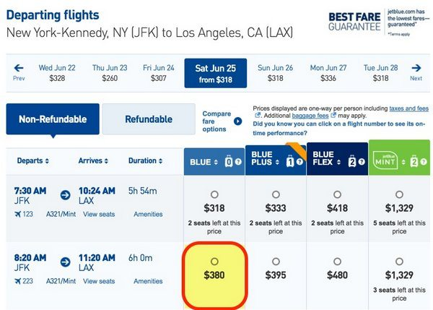
Illusion of scarcity
People more likely to desire things if they think they are rare
Notes:
http://psycnet.apa.org/journals/psp/32/5/906/

Slide 9
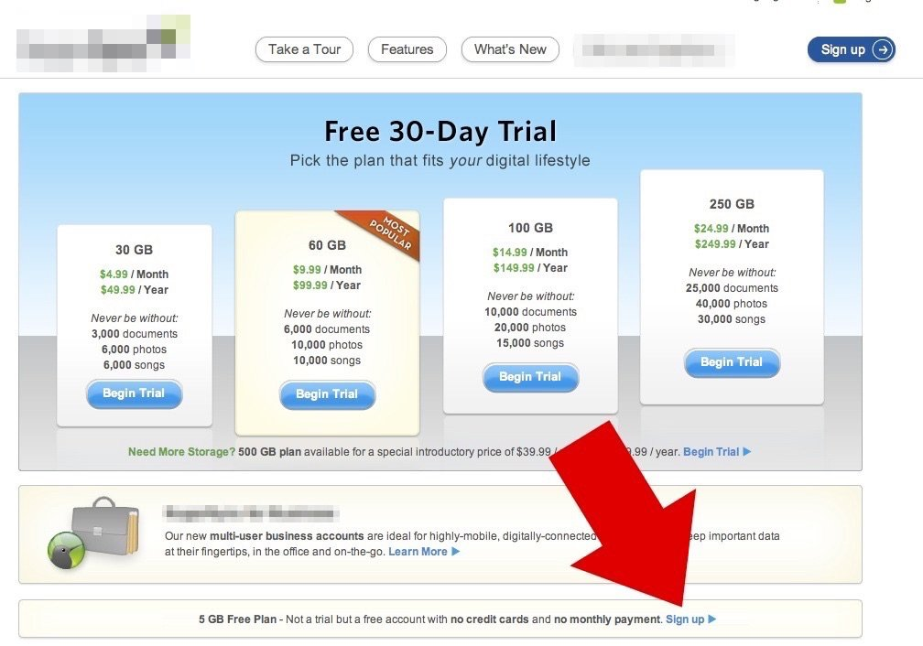
Loss aversion
1990 paper by Daniel Kahneman and his colleagues
People do not want to give up things they already have
Notes:
http://www.journals.uchicago.edu/doi/10.1086/261737

Slide 10
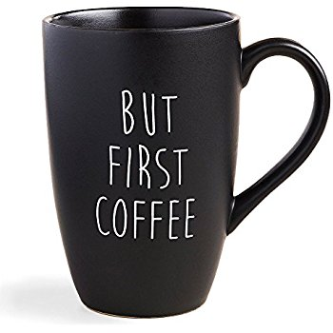
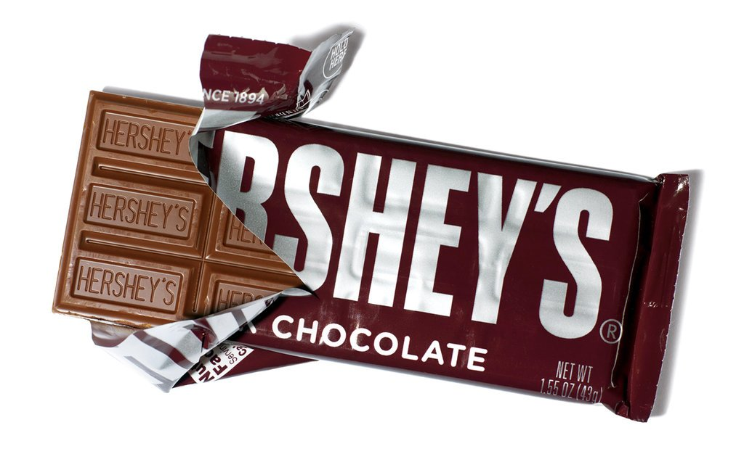
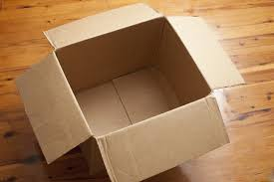
Loss aversion
Experiment
People given a mug, chocolate, or nothing
They were then asked if they wanted to switch items
Notes:
http://www.journals.uchicago.edu/doi/10.1086/261737

Slide 11
Loss aversion
Experiment
People given a mug, chocolate, or nothing
They were then asked if they wanted to switch items
For those that were given nothing, they chose the chocolate or mug in equal proportion
Notes:
http://www.journals.uchicago.edu/doi/10.1086/261737

Slide 12
Loss aversion
Experiment
People given a mug, chocolate, or nothing
They were then asked if they wanted to switch items
For those that were given nothing, they chose the chocolate or mug in equal proportion
However, 86% of people who had mugs kept their mugs, 90% of those given chocolate kept their chocolate
Notes:
http://www.journals.uchicago.edu/doi/10.1086/261737

Slide 13
Choices on magazine subscriptions
Notes:
Study by Duke professor Dan Ariely https://www.ted.com/talks/dan_ariely_asks_are_we_in_control_of_our_own_decisions?language=en

Slide 14
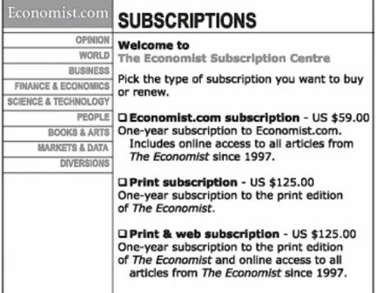
Choices on magazine subscriptions
Notes:
Study by Duke professor Dan Ariely https://www.ted.com/talks/dan_ariely_asks_are_we_in_control_of_our_own_decisions?language=en

Slide 15
Choices on magazine subscriptions
Notes:
Study by Duke professor Dan Ariely https://www.ted.com/talks/dan_ariely_asks_are_we_in_control_of_our_own_decisions?language=en

Slide 16
Choices on magazine subscriptions
Notes:
Study by Duke professor Dan Ariely https://www.ted.com/talks/dan_ariely_asks_are_we_in_control_of_our_own_decisions?language=en

Slide 17
Choices on magazine subscriptions
16%
68%
0%
84%
32%
Notes:
Study by Duke professor Dan Ariely https://www.ted.com/talks/dan_ariely_asks_are_we_in_control_of_our_own_decisions?language=en

Slide 18
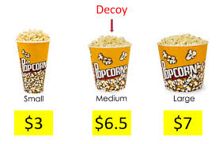
Decoy effect
The presence of a third object can influence your decision

Slide 19
Anchoring (with numbers)
Notes:
http://onlinelibrary.wiley.com/doi/10.1111/j.1559-1816.2011.00779.x/abstract

Slide 20
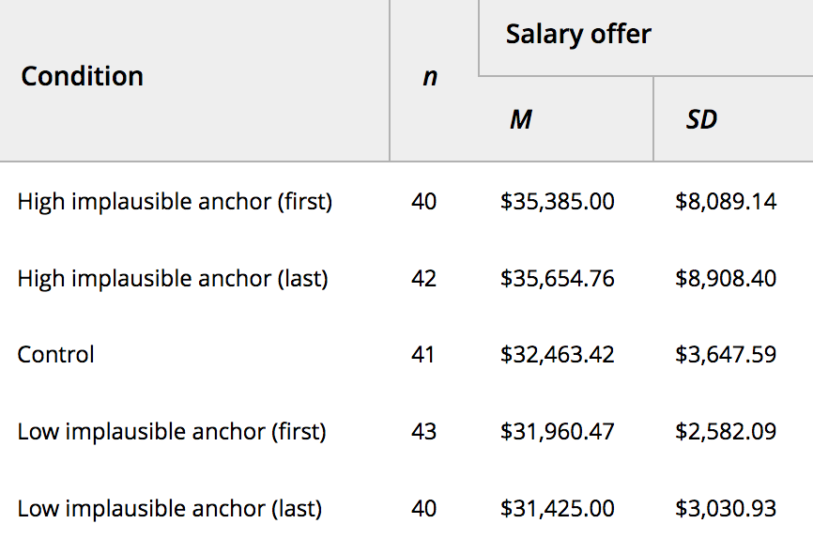
Anchoring (with numbers)
Notes:
http://onlinelibrary.wiley.com/doi/10.1111/j.1559-1816.2011.00779.x/abstract

Slide 21
Anchoring (with numbers)
Want to suggest a higher (even impossibly high) salary at the beginning of negotiations
Notes:
http://onlinelibrary.wiley.com/doi/10.1111/j.1559-1816.2011.00779.x/abstract

Slide 22
Super bowl ads
$5 million for each 30 second commercial
Why do commercials spend so much money on these advertisements?

Slide 23
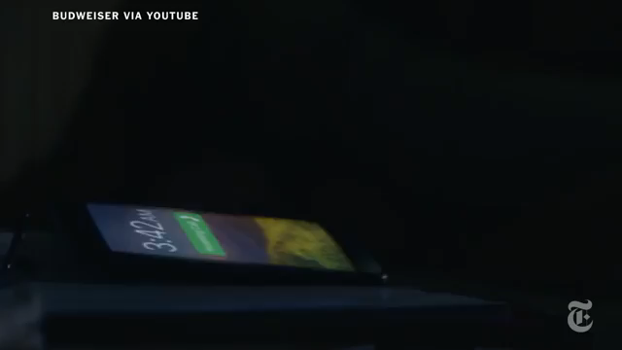
Emotional appeal

Slide 24
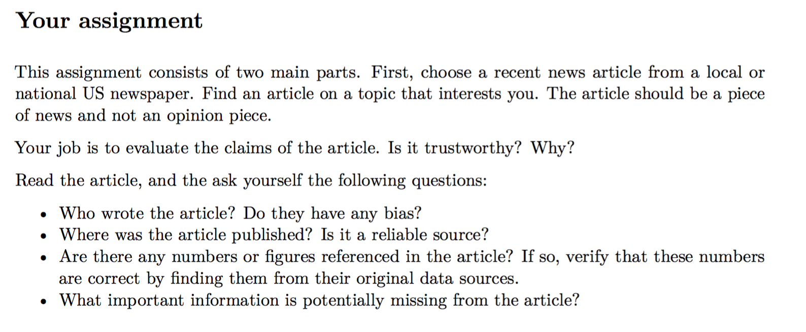
Homework for next week

